Slide 1
Assignment example
For each of the business challenges below, which component(s) of CUWN protect against them
Mitigate network misuse, hacking and malware from WLAN clients by inspecting traffic flows
Identify who is on the network and enforce granular policies to prevent exposure to viruses and “malware”
Streamline user experience, consolidate accounting, and improve password management
Standardize on wireless client connection policies while protecting them from suspect content and potential hackers
Supporting and maintaining a diverse range of security products, correlating events and delivering concise reporting
Offer secure, controlled access to network services for non employees and contractors
Notes:
IPS
Cisco NAC
NAC and CSA
CSA
CS-MARS
NAC and firewall

Slide 2
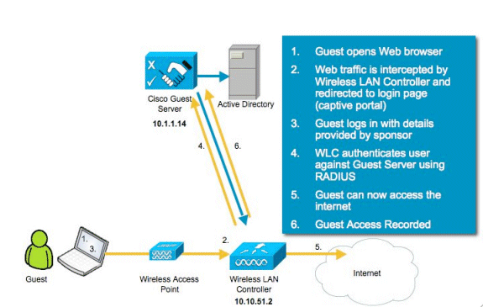
Guest Wireless

Slide 3
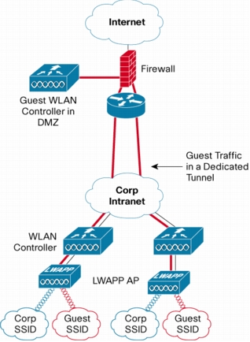
Guest Wifi Benefits
Network segmentation
Policy management
Guest traffic monitoring
Customizable access portals

Slide 4
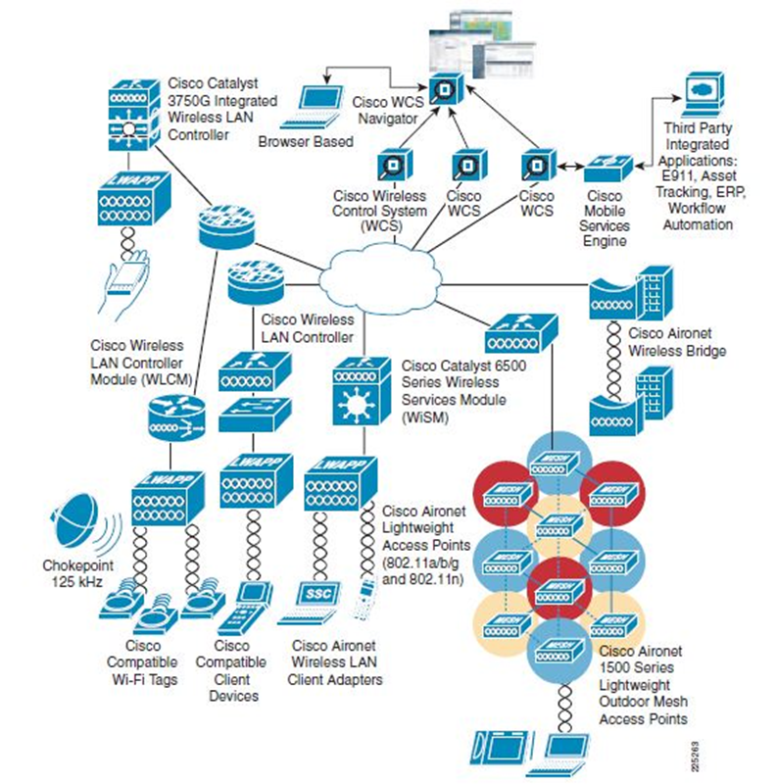
Conclusions
Present unparalleled threats
The Cisco Unified Wireless Network Solution provides the best defense against these threats

Slide 5
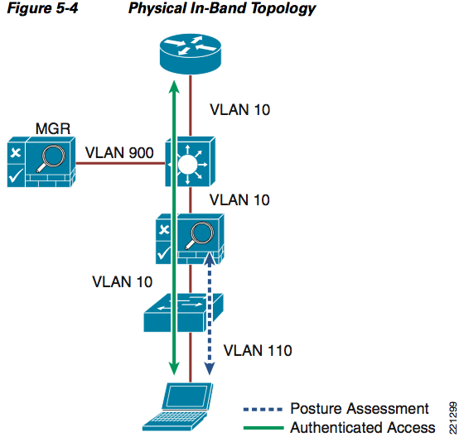
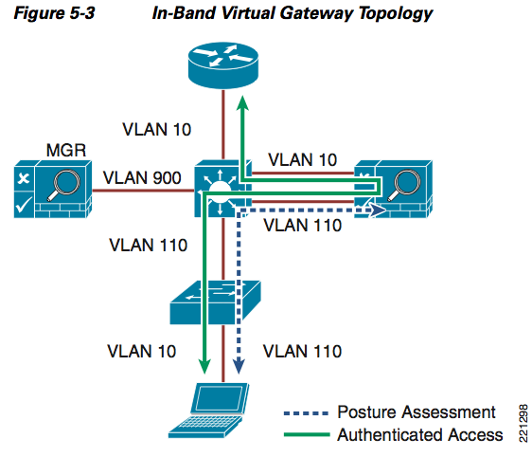
In-Band Modes
Notes:
When the NAC appliance is deployed in-band, all user traffic, both unauthenticated and authenticated, passes through the NAC appliance, which may be positioned logically or physically between end users and the network(s) being protected.
When the NAC appliance is configured as a virtual gateway, it acts as a bridge between end users and the default gateway (router) for the client subnet being managed.
When the NAC appliance is configured as a "real" IP gateway, it behaves like a router and forwards packets between its interfaces.

Slide 6
Compromised Clients
Wifi Threat | Security Concern | CSA Feature
Ad-hoc Connections | Wide-open connections Unencrypted Unauthenticated Insecure | Pre-defined ad-hoc policy
Concurrent wired/wifi connection | Contamenating secure wired environment | Concurrent wired/wifi pre-defined policy Disable wifi traffic if wired detected
Access to unsecured wifi | May lack authentication / encryption Risk of traffic cracking, rogue network devices | Location based policies Restrict allowed SSIDs Enforce stronger security policies

